Slide 1
Not imputed

Slide 2
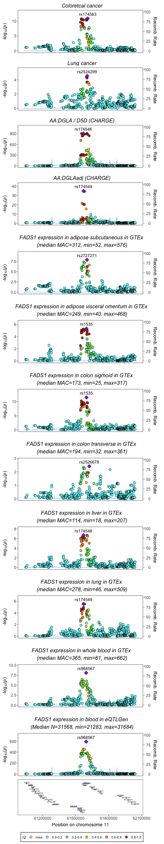
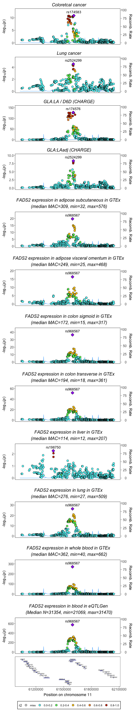
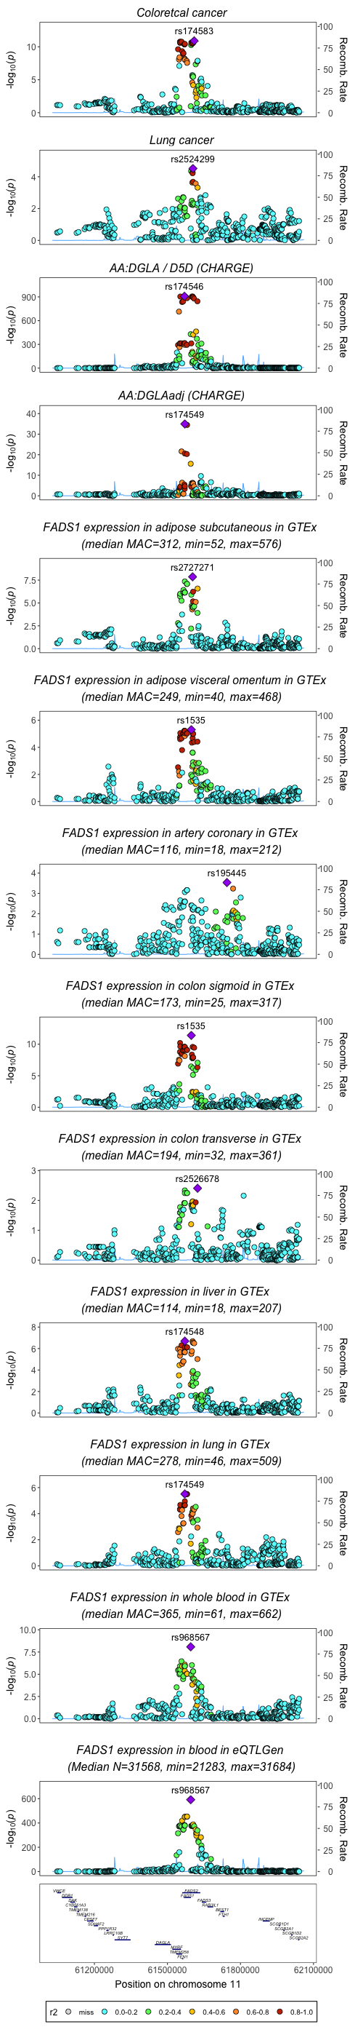
Cancer associations plus marginal and conditional FADS1 and FADS2 associations in CHARGE
FADS1
FADS2
Plus eQTLs in coronary tissue

Slide 4
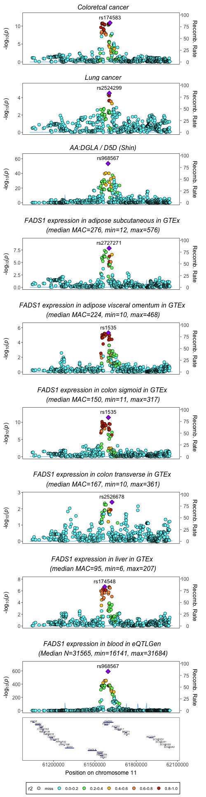
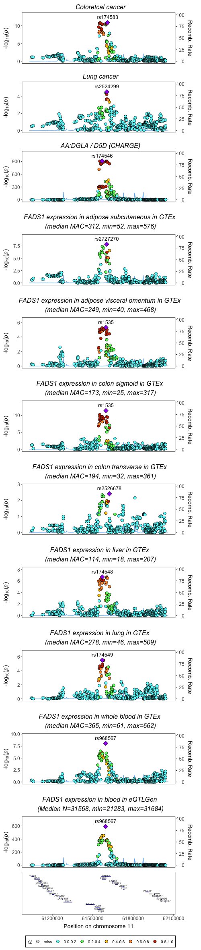
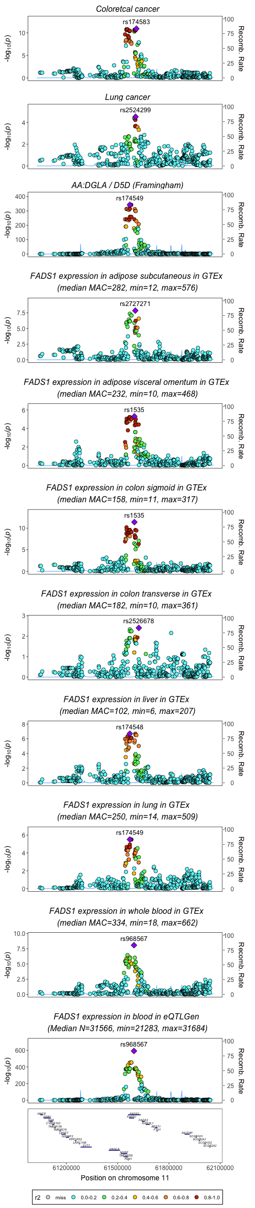
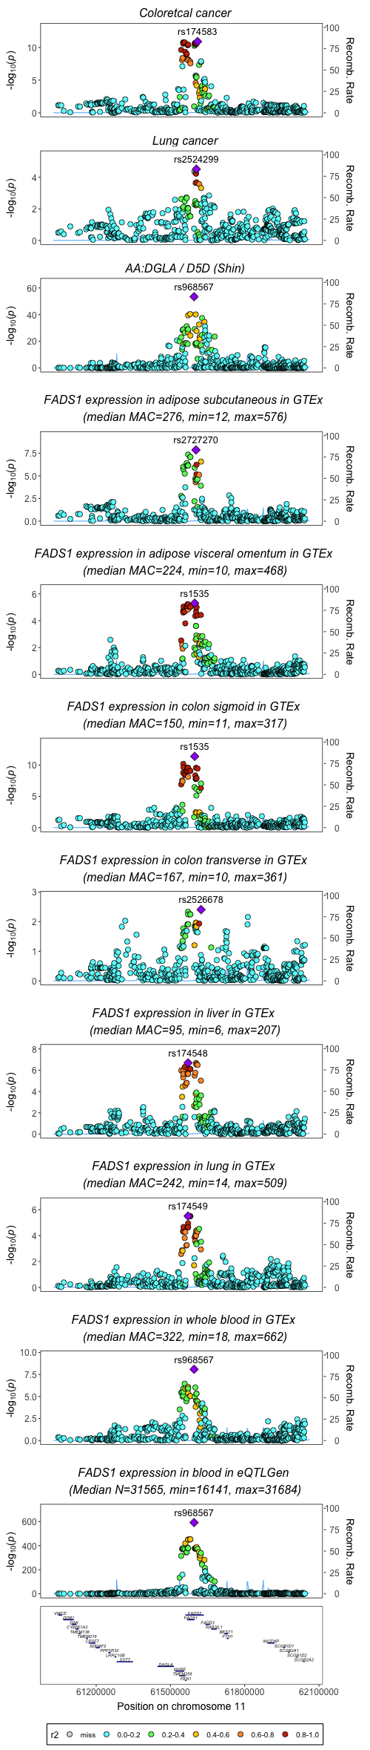
Cancer and FADS1 associations in CHARGE, Framingham and Shin

Slide 5
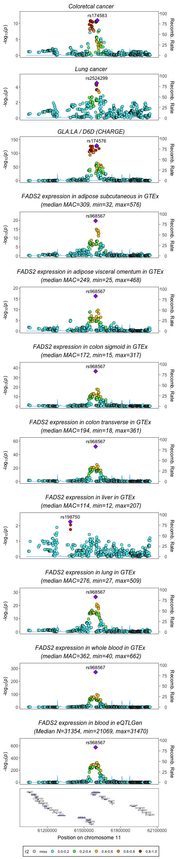
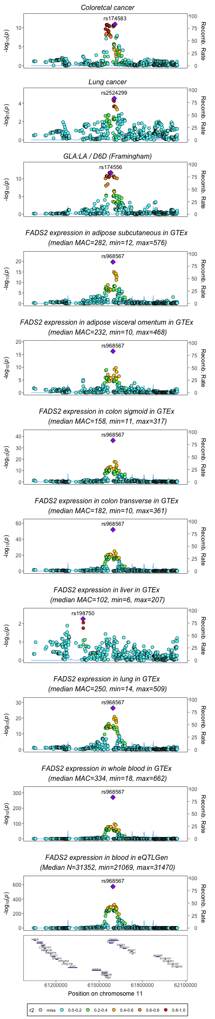
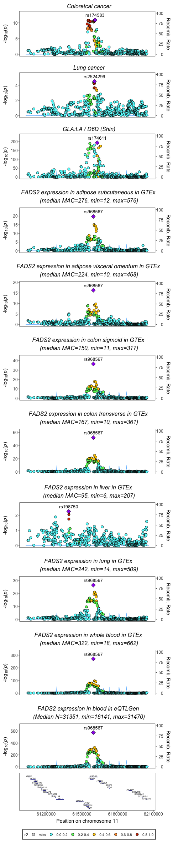
Cancer and FADS2 associations in CHARGE, Framingham and Shin

Slide 7
Imputed

Slide 8
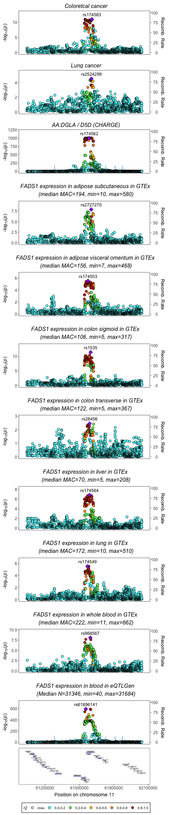
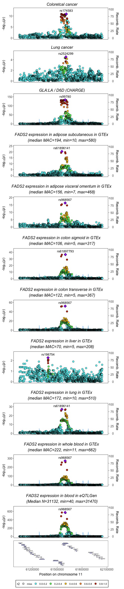
Cancer, FADS1 and FADS2 associations in CHARGE

Slide 9
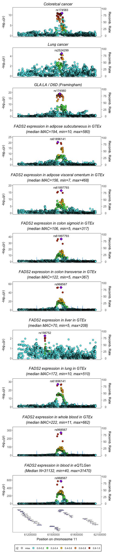
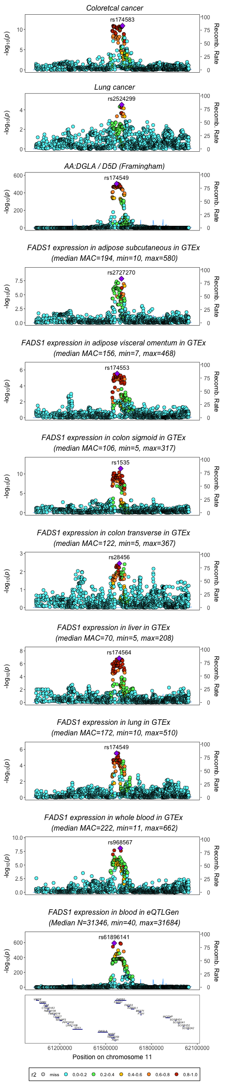
Cancer, FADS1 and FADS2 associations in Framingham

Slide 10
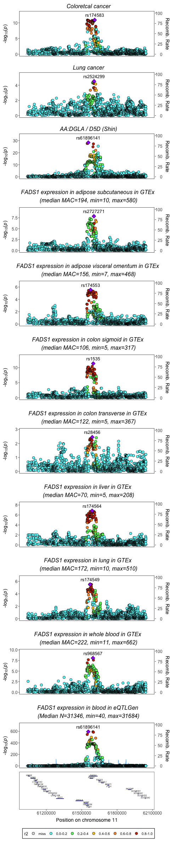
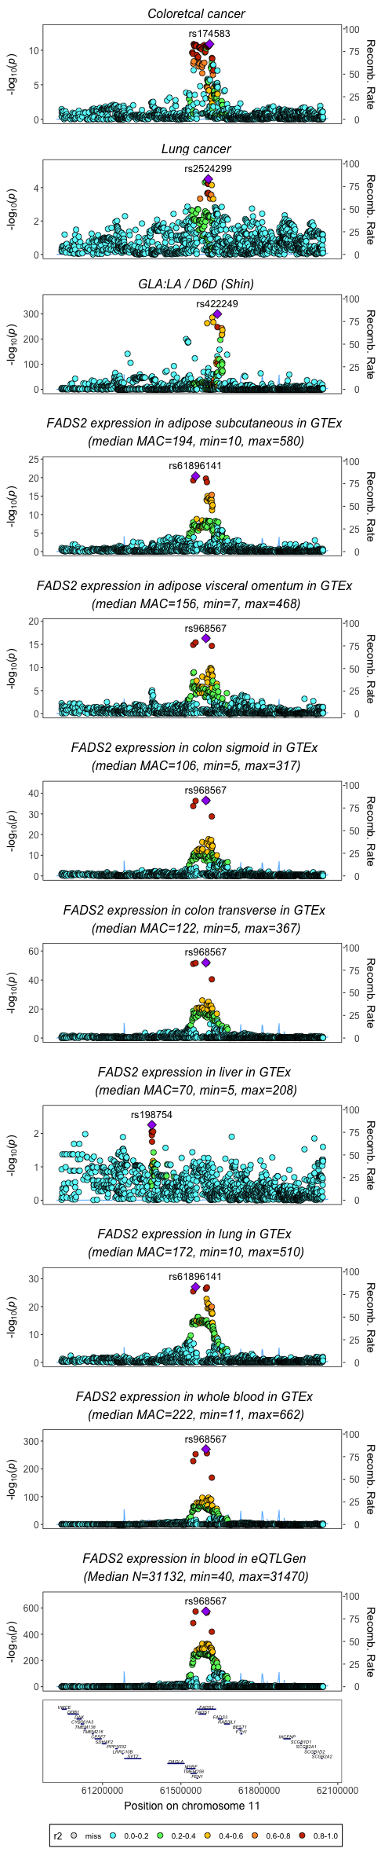
Cancer, FADS1 and FADS2 associations in Shin

Slide 11
500kb

Slide 12
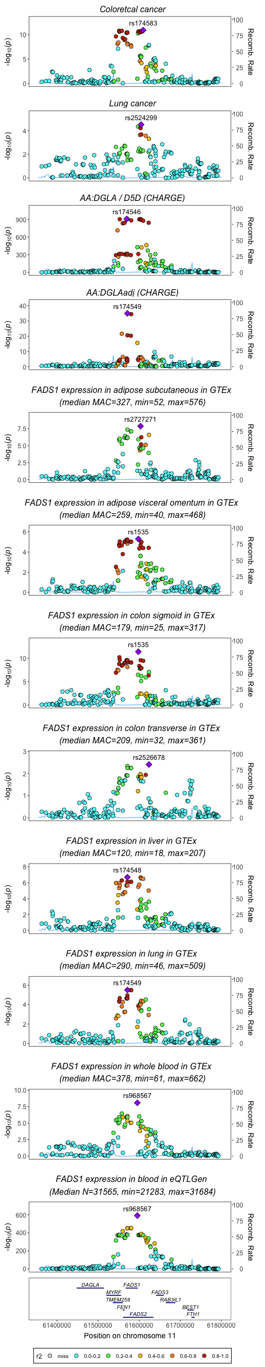
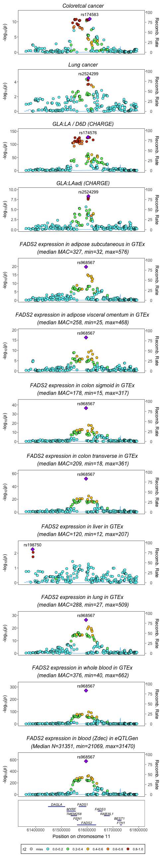
Regional association plots for FADS1 and FADS2 and cancer (using non-imputed data for fatty acids for CHARGE)
Conditional results

Slide 13
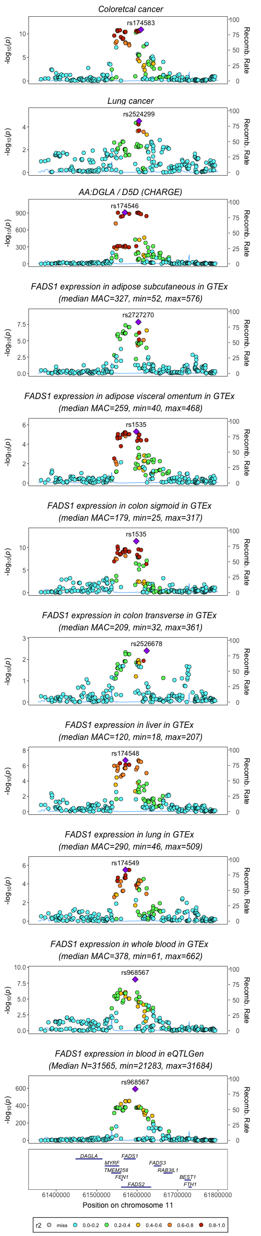
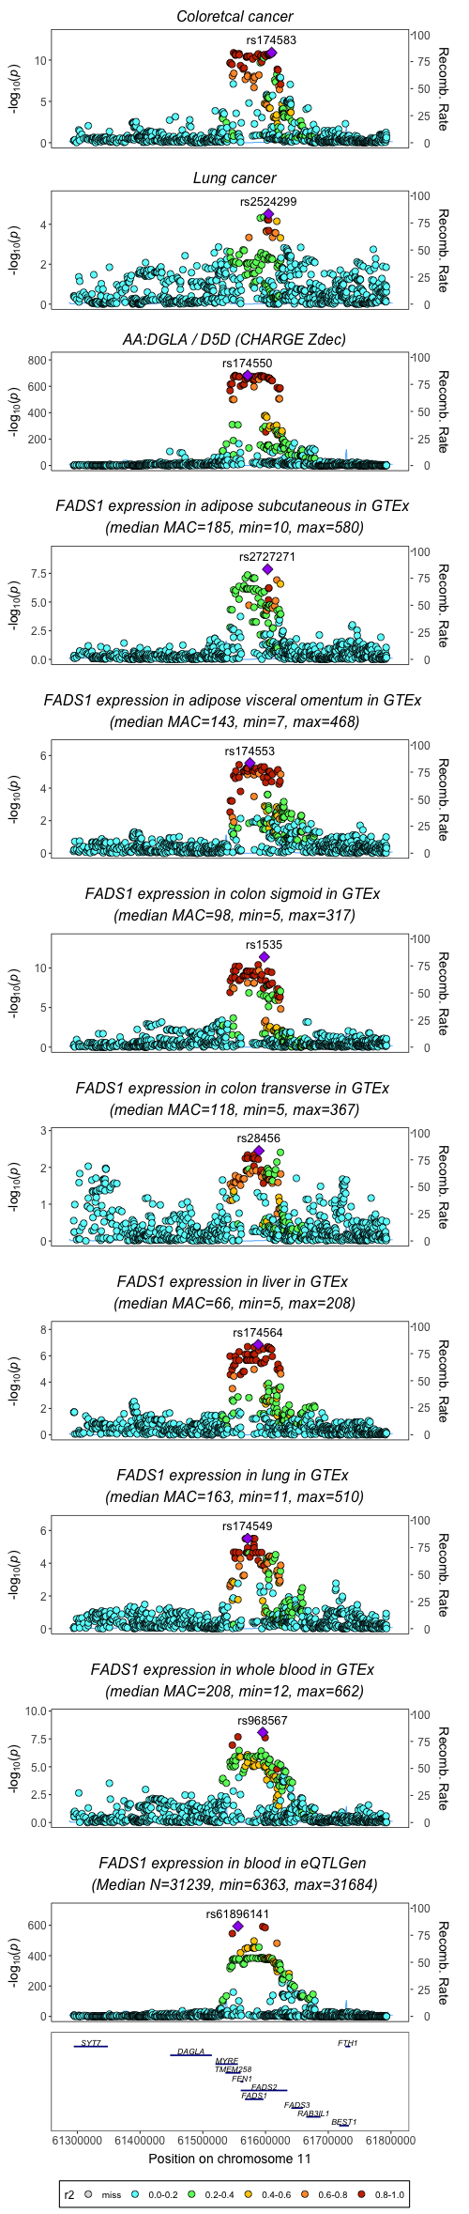
Regional association plots for FADS1 and cancer using imputed and non-imputed fatty acid datasets from CHARGE

Slide 14
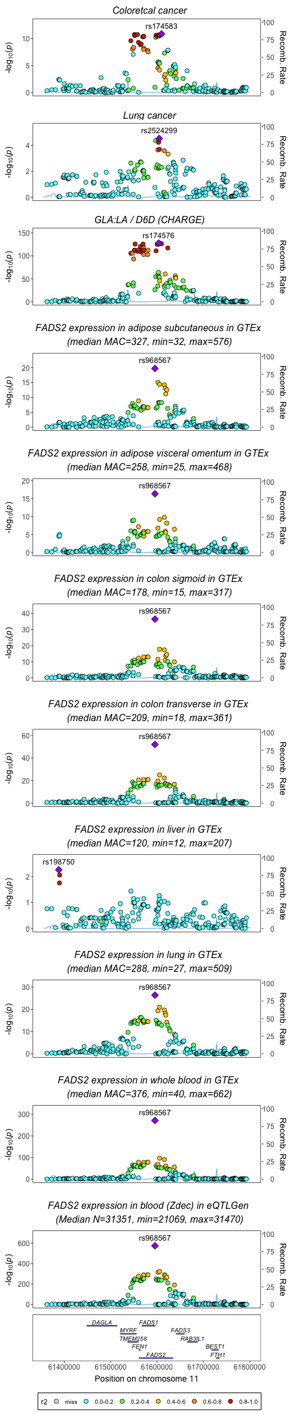
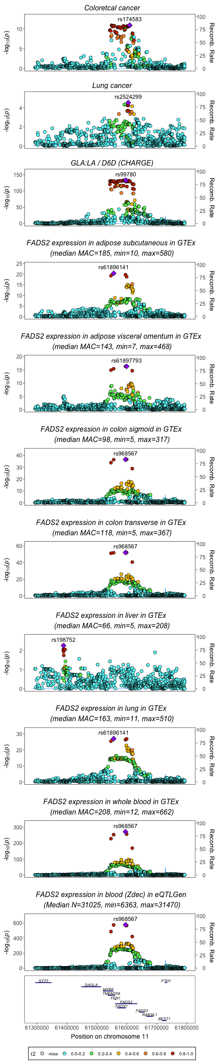
Regional association plots for FADS2 and cancer using imputed and non-imputed fatty acid datasets from CHARGE

Slide 15
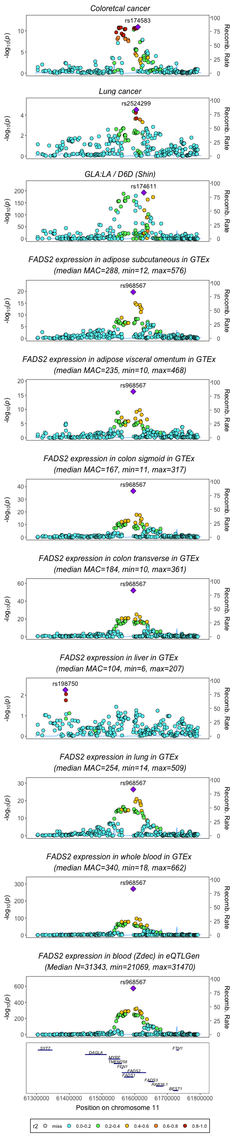
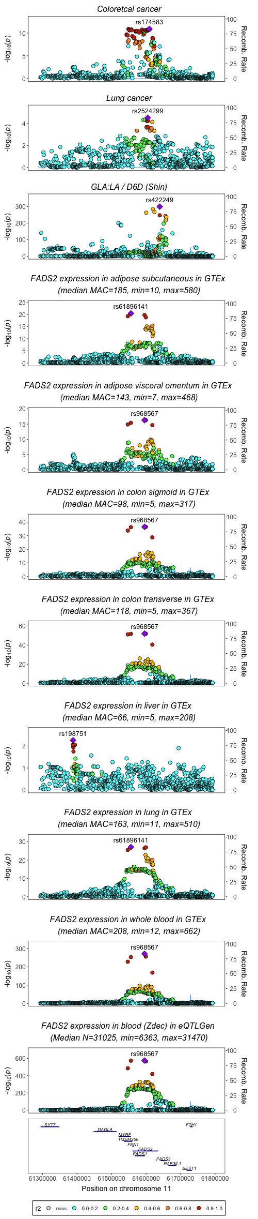
Regional association plots for FADS2 and cancer using imputed and non-imputed fatty acid datasets from Shin

Slide 16
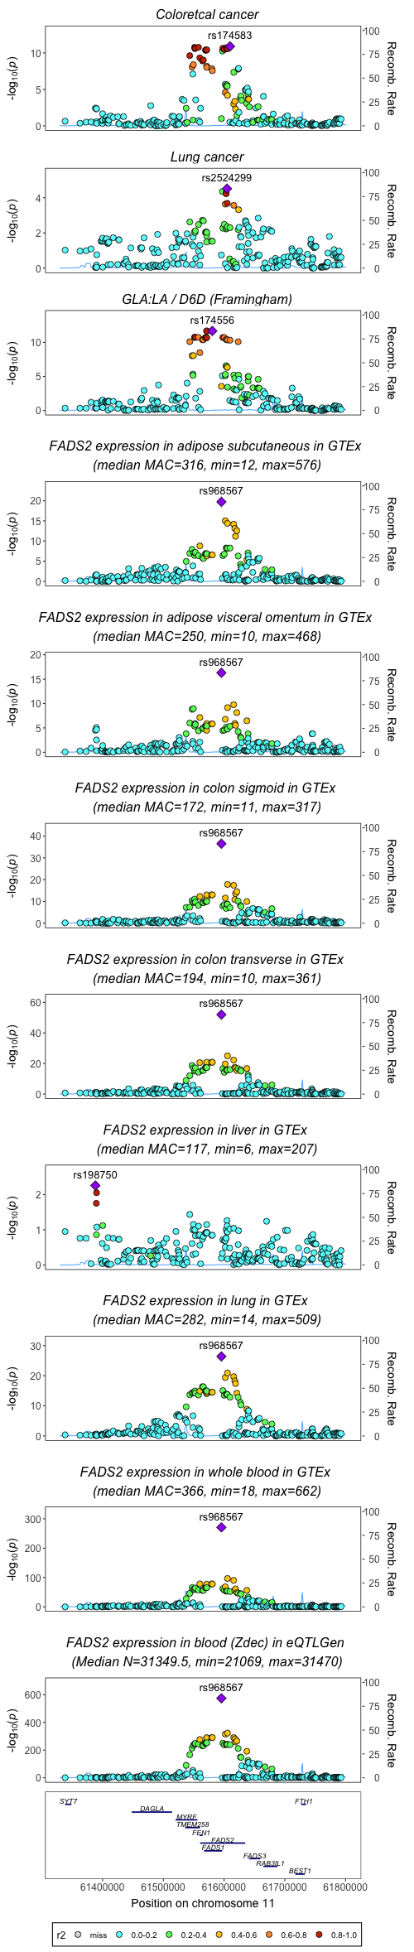

Regional association plots for FADS2 and cancer using imputed and non-imputed fatty acid datasets from Framingham

Slide 17
Top markers labelled

Slide 18
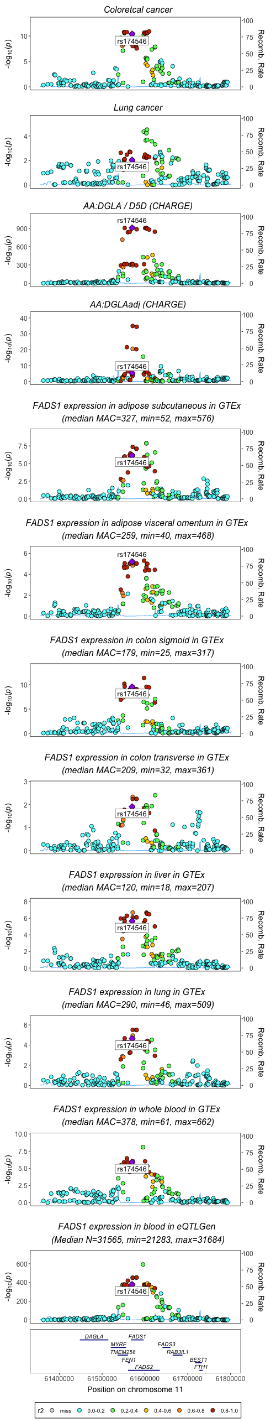
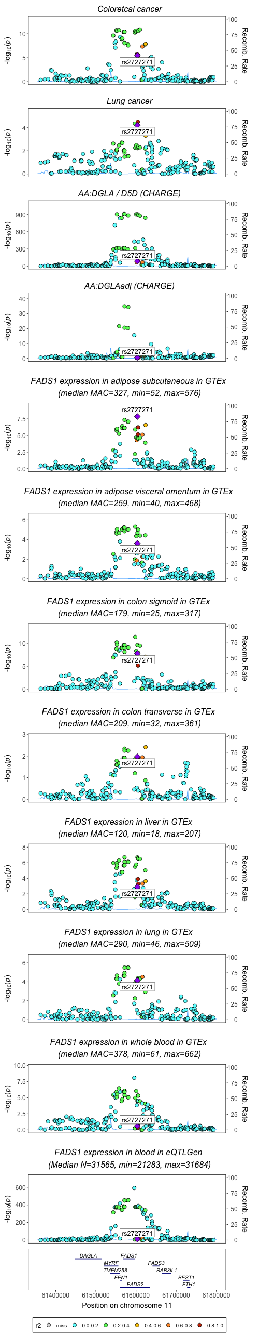
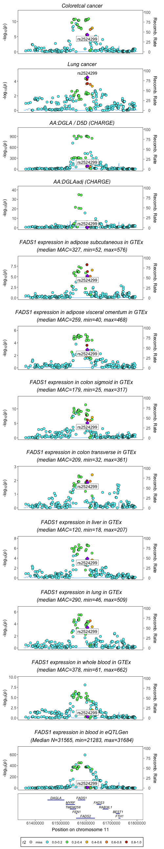
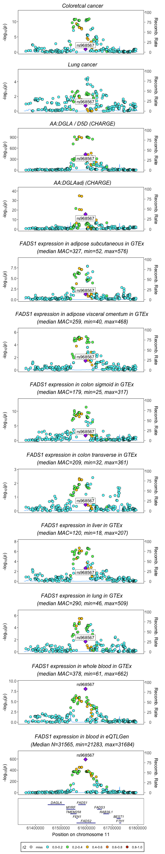
Position of rs174546, rs2524299 and rs968567 in associations for FADS1 activity/expression and cancer (non imputed data for fatty acids from CHARGE)
R2=0.929 rs2524299 and rs2727271

Slide 19
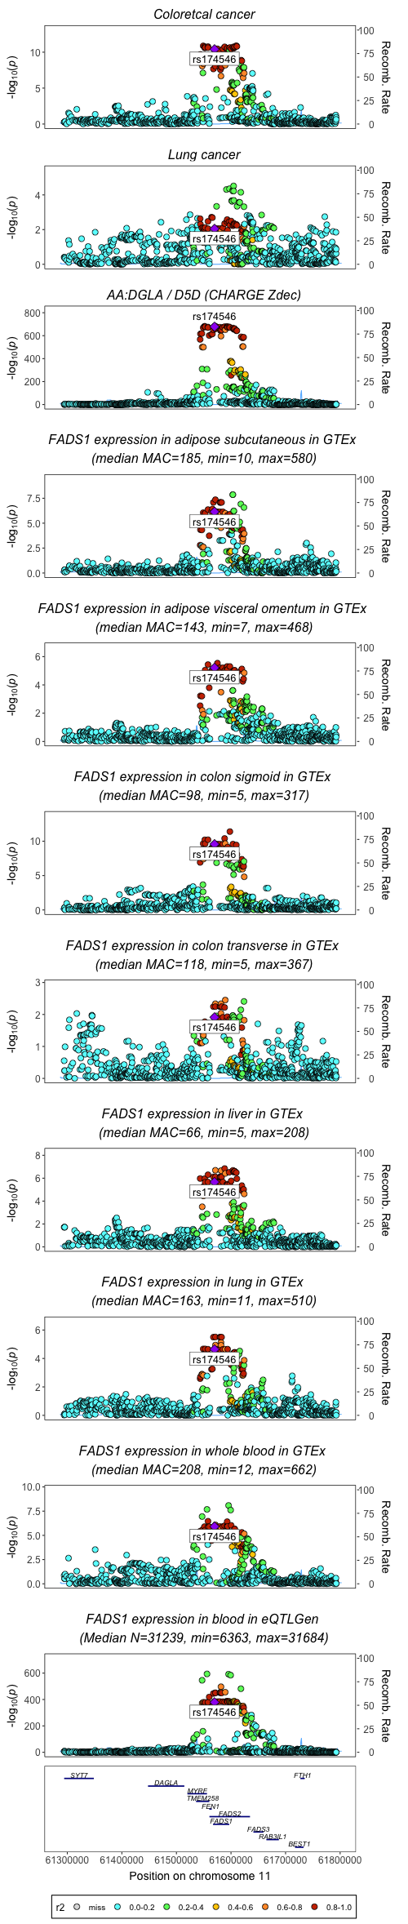
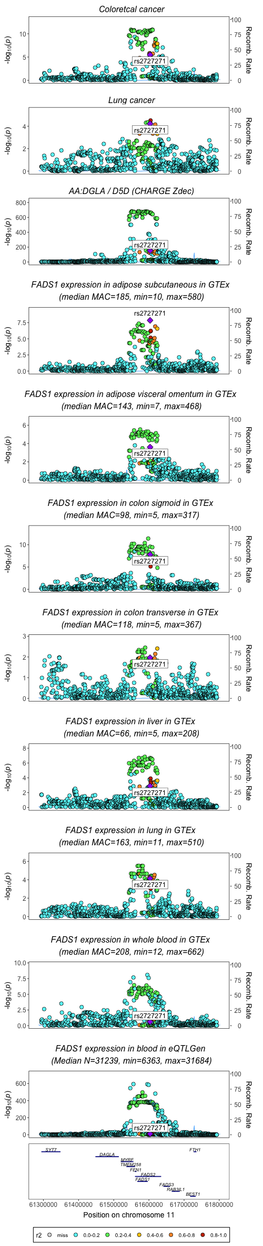

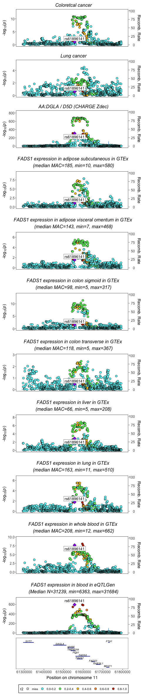
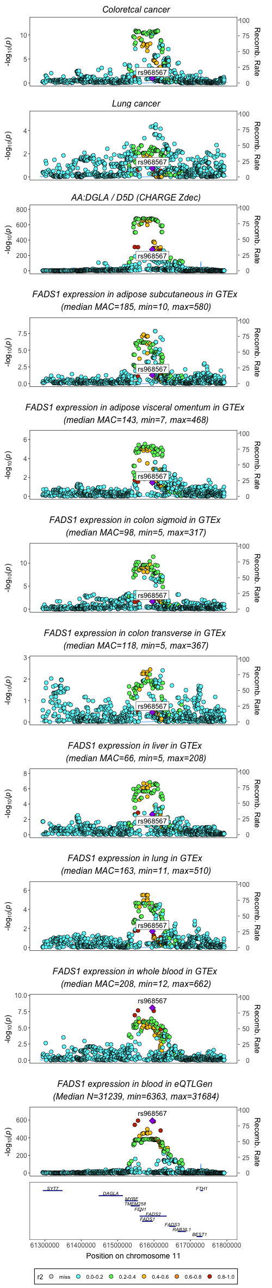
Position of rs174546, rs2524299, rs968567 in associations for FADS1 activity/expression and cancer (imputed dataset for fatty acids from CHARGE)
R2=0.929 rs2524299 and rs2727271
R2= 0.981 rs968567 and rs61896141

Slide 20
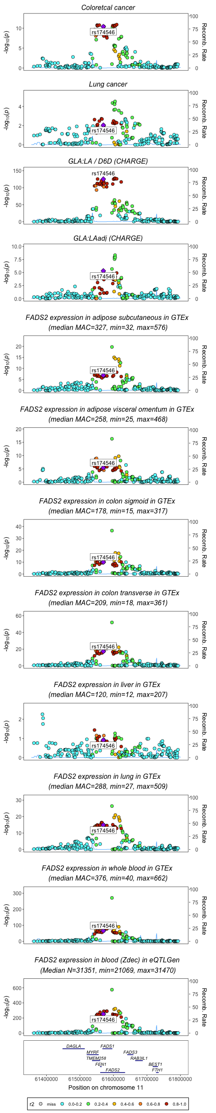
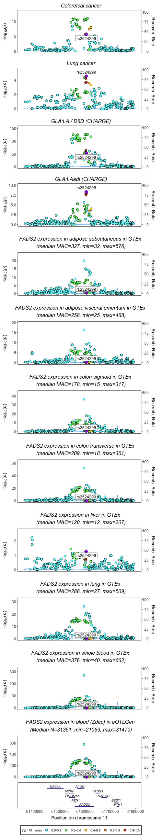
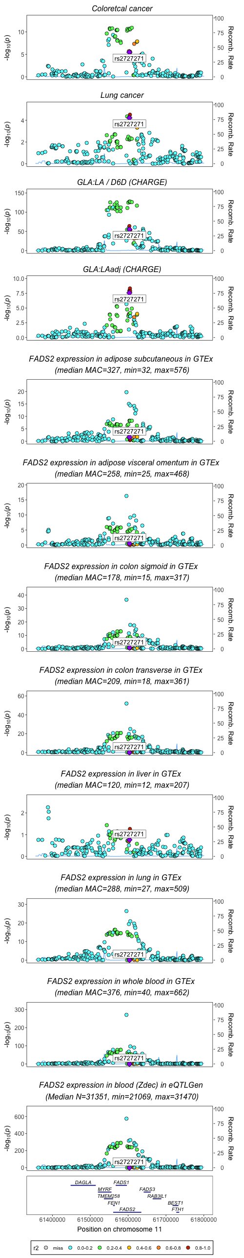
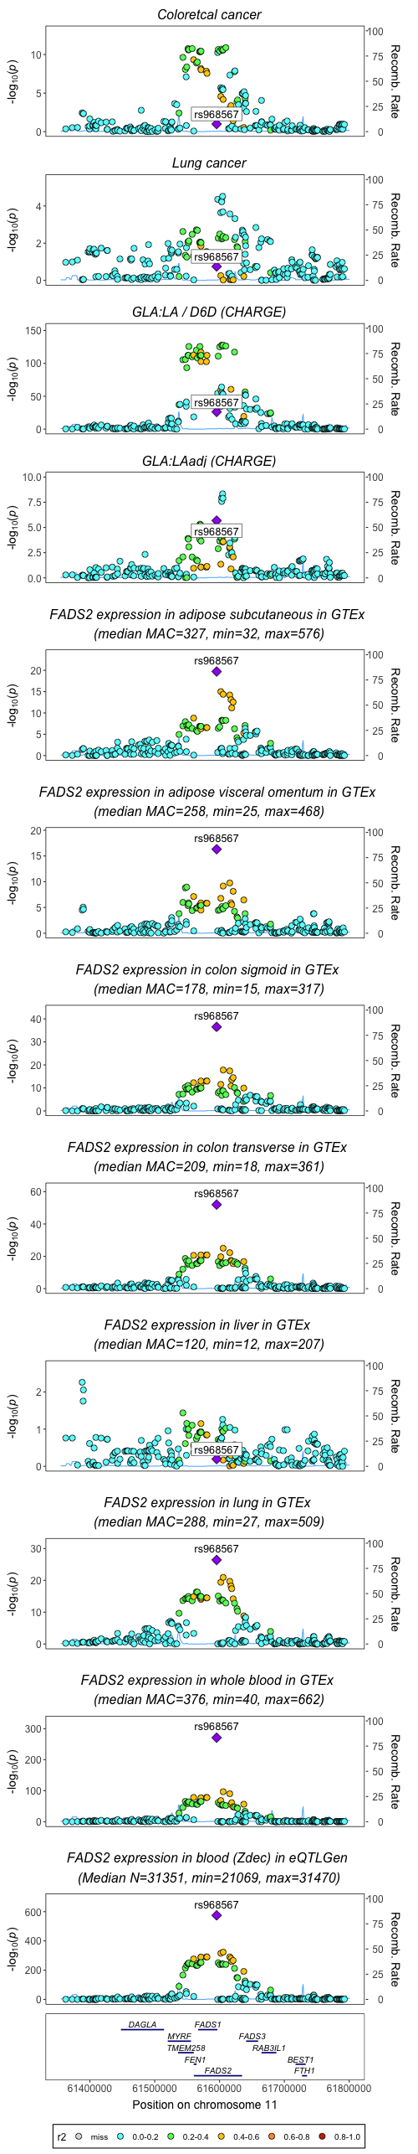
Position of rs174546, rs2524299, rs968567 in associations for FADS2 activity/expression and cancer (non imputed data for fatty acids from CHARGE)
R2=0.929 rs2524299 and rs2727271

Slide 21
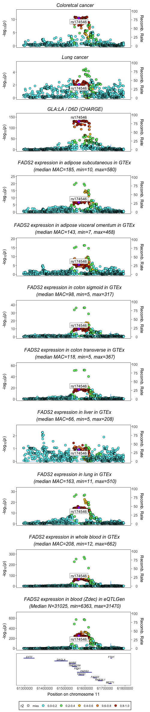
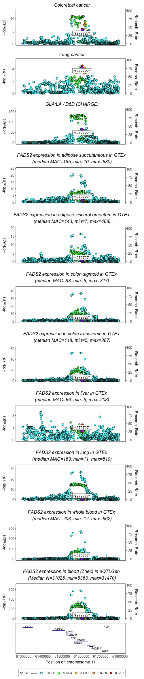
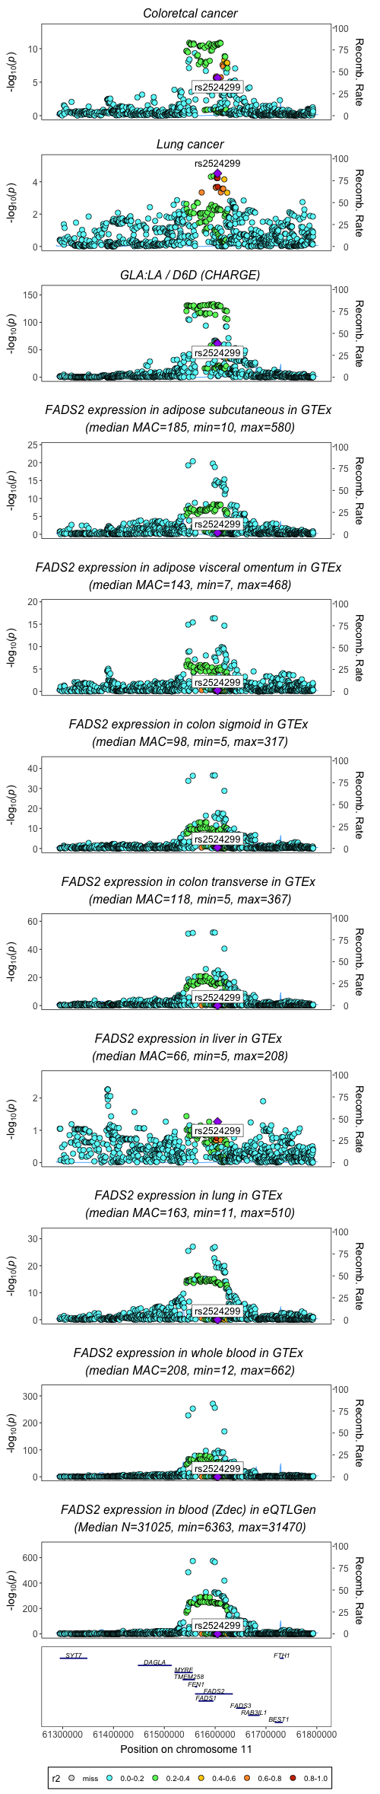
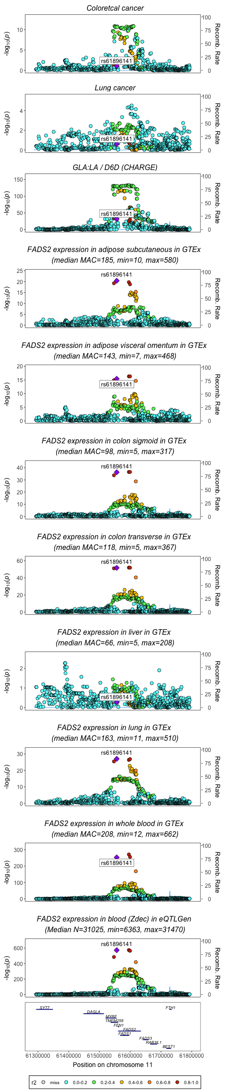
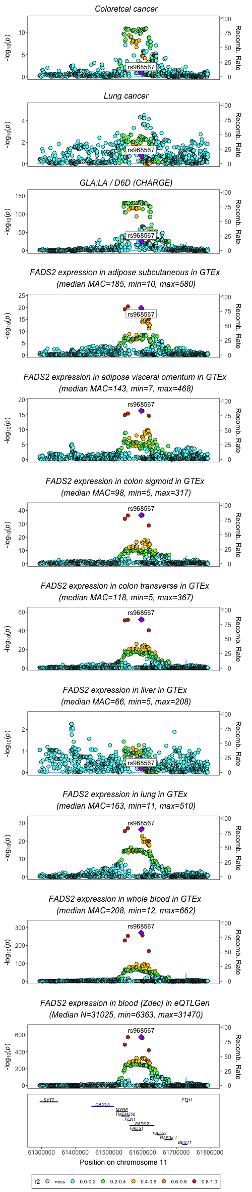
rs174546, rs2524299, rs968567 and associations with FADS2 activity and expression and cancer (imputed dataset for fatty acids)
R2=0.929 rs2524299 and rs2727271
R2= 0.981 rs968567 and rs61896141

